Slide 1
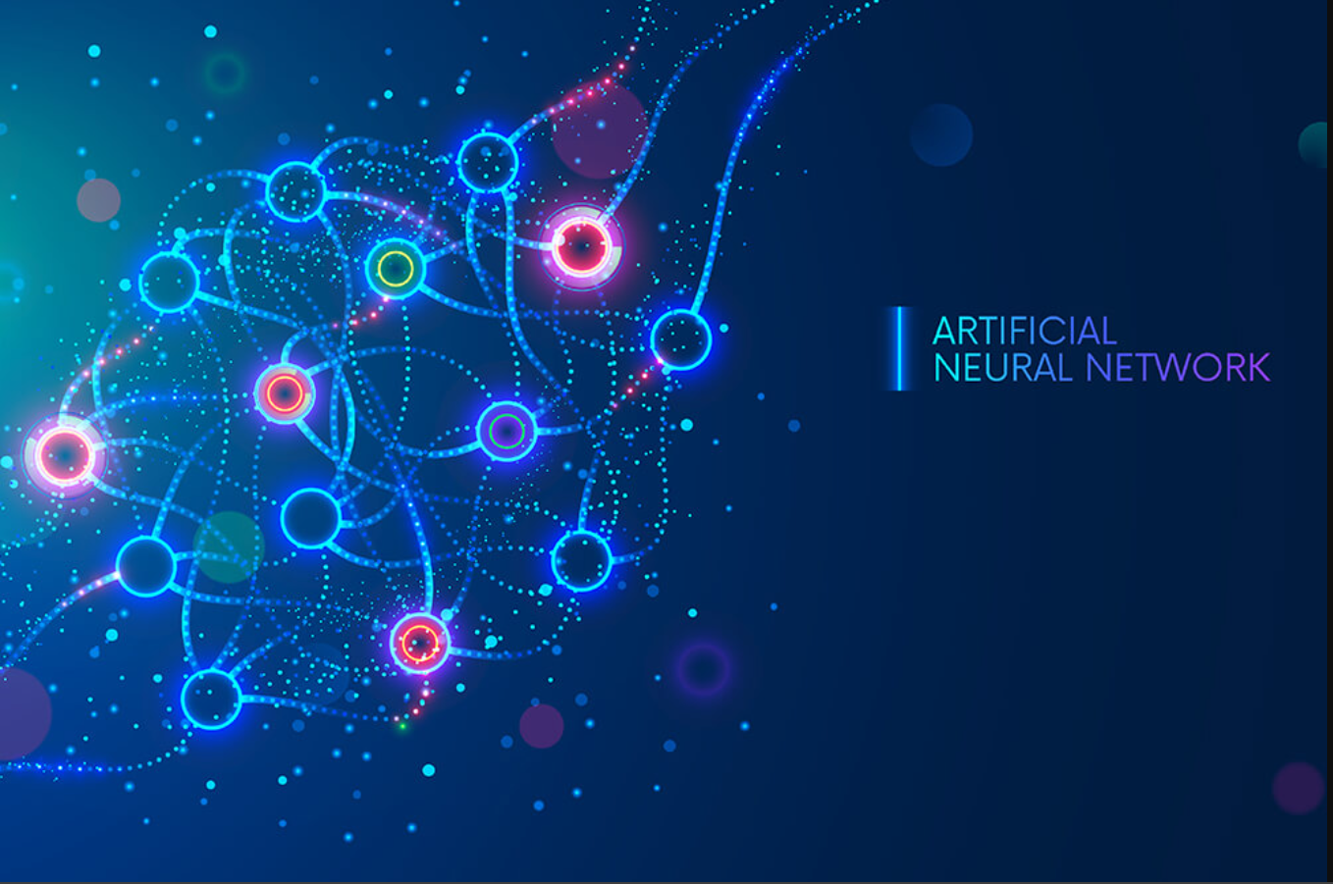
Neural network in a.i.
By – presha Navya azmah

Slide 2
What is neural network?
A neural network is a method in artificial intelligence that teaches computers to process data in a way that is inspired by the human brain. It is a type of machine learning process, called deep learning, that uses interconnected nodes or neurons in a layered structure that resembles the human brain.

Slide 3
Why are neural networks important?
Neural networks are a robust tool that businesses use to solve complex business problems. Companies use this form of network to identify patterns and predict rare events like fraud detection.
These networks are capable of developing a relationship between non-linear and complex inputs and outputs. This makes them perfect for projects that require data-based decisions to achieve success.

Slide 4
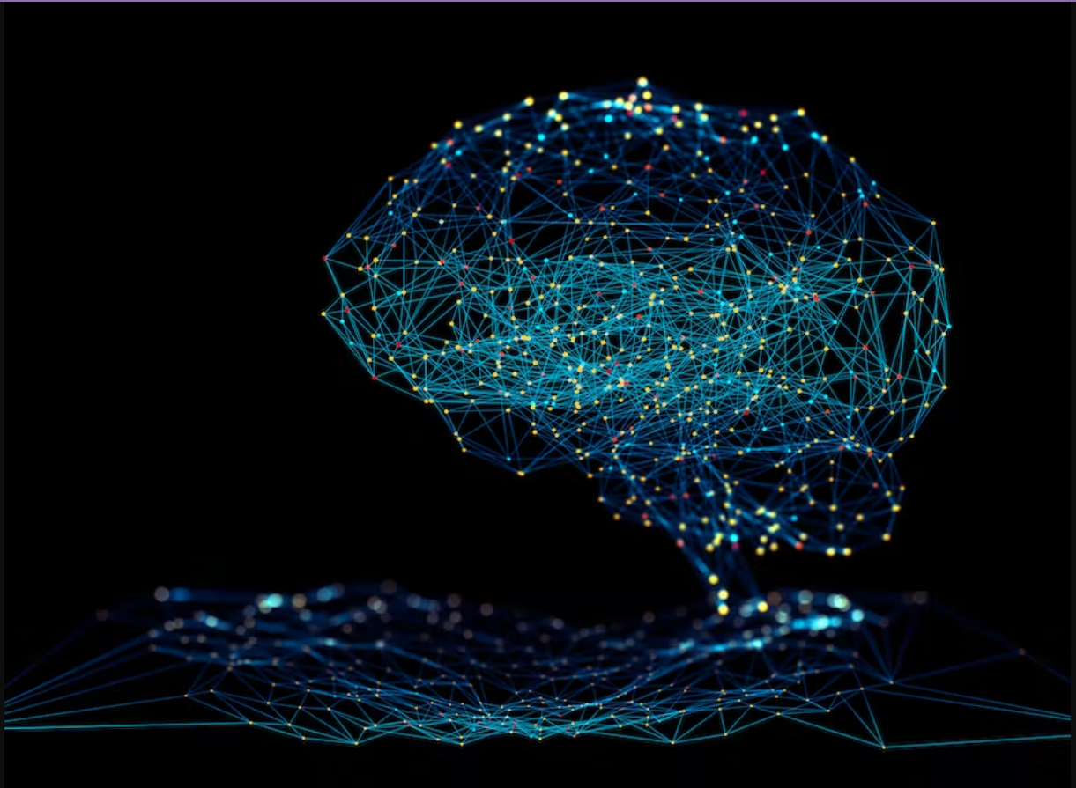
Advantages of Artificial Neural Network
Parallel processing capability
Storing data on the entire network
Capability to work with incomplete knowledge
Having fault tolerance & many more.

Slide 5
Characteristics of Artificial Neural Network
It is neurally implemented mathematical model.
It contains huge number of interconnected processing elements called neurons to do all operations.
Information stored in the neurons are basically the weighted linkage of neurons.
The input signals arrive at the processing elements through connections and connecting weights.
It has the ability to learn , recall and generalize from the given data by suitable assignment and adjustment of weights.
The collective behavior of the neurons describes its computational power, and no single neuron carries specific information.

Slide 6
Thank You

